Slide 1
“Indoor Fingerprinting Based on Deep Neural Network and Random Forest with Calibrated Wi-Fi RTT "
Kyungpook National University
School of Electronic and Electrical Engineering
Lila Rana
2023.05.01
Notes:
Good Afternoon respected Professor, lab senior, and my lab mates. I am Lila Rana. and I'm pleased to be here today to present my seminar on Indoor Fingerprinting Based on Deep Neural Networks and Random Forests with Calibrated Wi-Fi RTT. Today, I’ll share with you the results of my research work which explores the improvements in position estimation in RTT for indoor positioning systems.

Slide 2
Contents
Introduction
Theoretical Background
Wi-Fi RTT Data Acquisition
Data Preprocessing
Proposed Model Architecture
DNN Model Training
Random Forest Algorithm Training
Result and Analysis
Conclusion
References

Slide 3
Introduction
Wi-Fi-based localization system is a popular choice due to their wide availability and low cost for Indoor applications.
Wi-Fi Round-Trip-Time (RTT) measurements have shown promise in providing accurate distance measurements.
Accuracy of these measurements can be affected by several factors, such as noise and interference in communication.
Main motives:
To address the limitations of existing localization estimation techn-iques.
To provide a more accurate and reliable indoor localization, tracki-ng, and navigation system solution.

Slide 4
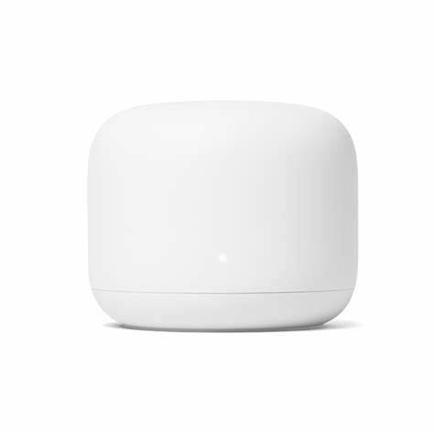
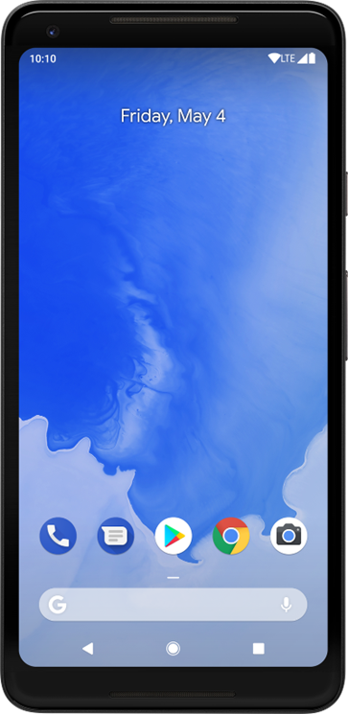
Theoretical Background
Wi-Fi RTT (IEEE 802.11mc) is based on Time-of-Flight (ToF).
In Wi-Fi RTT, the signal used for ToF measurements is the “Fine Timing Measurement" (FTM) frame.
When the transmission timestamp of the FTM message and the reception of the ACK in the k^{th} procedure of a burst;
RTT = (t_{4_k} − t_{1_k} ) − (t_{3_k} − t_{2_k})
t_{4_k} is the receiving time of ACK, and t_{1_k} is the transmission time of the FTM message.
(t_{3_k} − t_{2_k}) is the processing time in the initiator (smartphone).
(Initiator)
(Responder)
Initial FTM request
ACK
FTM_1
t_{1_1}
t_{2_1}
1st FTM
Interchange
t_{3_1}
ACK
t_{4_1}
FTM_2
t_{1_2}
t_{2_2}
t_{3_2}
2nd FTM
Interchange
ACK
t_{4_2}
…
Notes:
Before diving into the specifics of my research, I'd like to provide some context on the theoretical background of Wifi RTT. Understanding the underlying principles of WiFi is essential for understanding the research findings I'll be sharing today. (t4 − t1) represents the estimated round trip time including the processing time at the mobile device while the term (t3 − t2) represents the processing time at the mobile device.

Slide 5
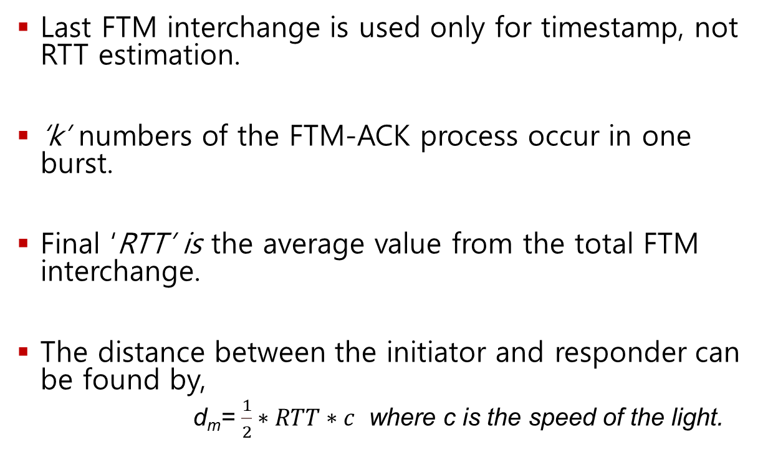
Theoretical Background (contd.)
Last FTM interchange is used only for timestamp, not RTT estimation.
‘k’ numbers of the FTM-ACK process occur in one burst.
Final ‘RTT’ is the average value from the total FTM interchange.
The distance between the initiator and responder can be found by,
d_{m}= $\frac{1}{2}∗RTT∗c$ where c is the speed of the light.
(Initiator)
(Responder)
Initial FTM request
ACK
FTM_1
t_{1_1}
t_{2_1}
1st FTM
Interchange
t_{3_1}
ACK
t_{4_1}
FTM_2
t_{1_2}
t_{2_2}
t_{3_2}
2nd FTM
Interchange
ACK
t_{4_2}
…

Slide 6
Theoretical Background (contd.)
All clock systems in nature suffer from skew, drift, and jitter.
Clock skew can occur due to the difference in clock frequencies of devices -or due to clock drift.
Device synchronization using IEE 8021.11mc; clocks may drift or skew over time.
Measurement Noise also occurred due to random variation or error caused by device hardware, signal propagation, and environmental conditions.
Jitter is the deviation from the ideal or expected timing of a clock signal ca-used by various factors such as noise, interference, and other sources of sig-nal distortion.

Slide 7
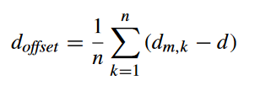
Theoretical Background (contd.)
Offset data can be calculated by using periodic offset calibration.
Collection of time-series RTT range readings at each reference point is
used to calibrate the range d_{offset} which is calculated as follows:
Finally, RTT range can be found by the following:
d= d_{m}-d_{offset}+W where W is the random measurement noise(Guo et al., 2019)
where d_{m,k} measurement at the reference point, and d is
the geometric range between the transmitter

Slide 8
Wi-Fi RTT Data Acquisition
Collected Wi-Fi Round-Trip-Time (RTT) measurements between a mobile device and google Wi-Fi access points (AP).
The lowest latency of sending ranging requests from RTT-enabled smartphones is 100ms in theory.
Google recommended that the sampling interval should not be shorter than 200 ms to avoid collisions and other software problems. (Dong et al., 2022)
We set the 200 ms latency, which means one sample per 200 ms.
Notes:
In order to conduct my research on this, I collected wifi RTT by using Wifi Mesh Router and a smartphone.

Slide 9
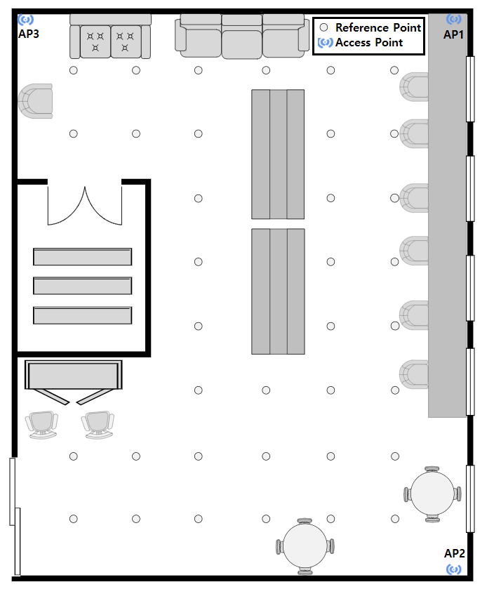
Wi-Fi RTT Data Acquisition (contd.)
Data collection work done in the Loun-ge room on the 8th floor of the IT1 building at KNU.
One smartphone Google Pixel 2 and 3 Google Pixel Nest Wi-Fi Router as an Access point.
Constructed the Reference points(RP) at every 1m difference in both axes.
Access Points: 3
Reference Points: 36
Figure: Experiment Environment Map

Slide 10
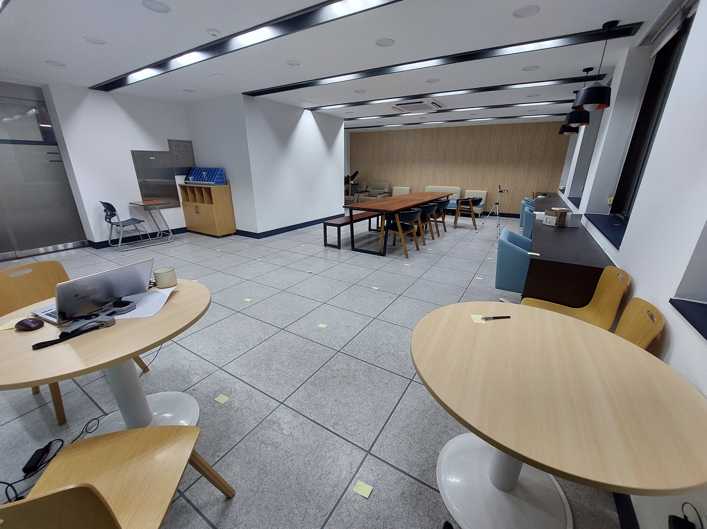
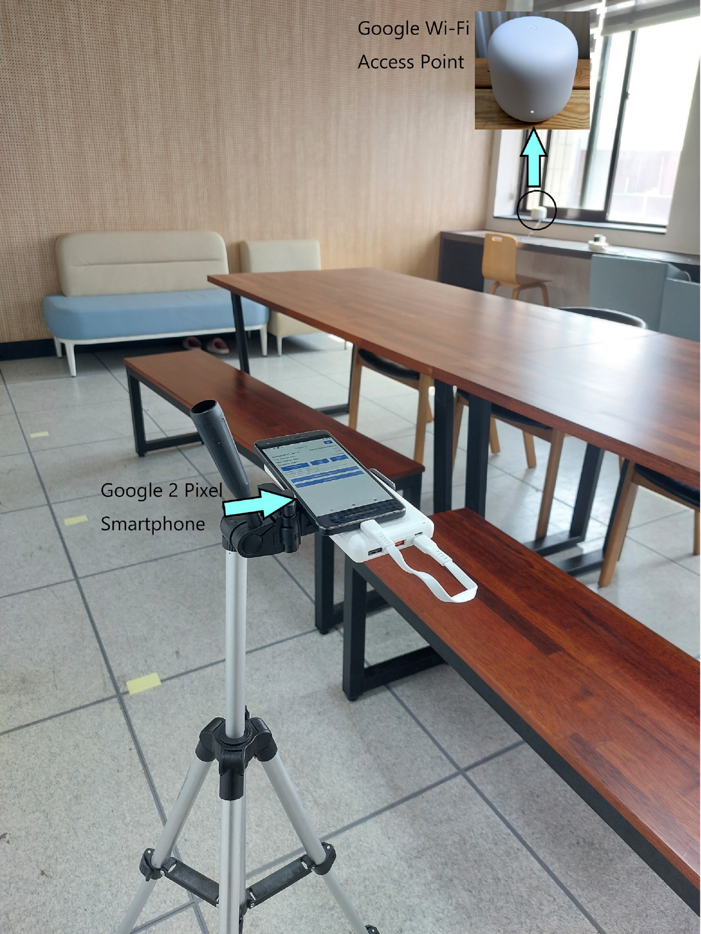
Wi-Fi RTT Data Acquisition (contd.)
Figure: Real Experiment Environment

Slide 11
Wi-Fi RTT Data Acquisition (contd.)
Each dataset included a timestamp, RTT range, RSS, standard deviation, and the number of successful RTT measurements.
Used an Android application named WifiRttScan developed by Google to send ranging re-quests and collect the ranging results.
All tests were conducted on a desktop computer with an Intel i3-12100 CPU running at 3.30 GHz and 16 GB of installed memory.
Our proposed method was implemented using Python 3.10.10 and TensorFlow 2.11.0
Device Name | Chipset/ Wi-Fi Standard
Google Pixel 2 | Snapdragon 835 Android 11
Google Nest WiFi | AC2200 4*4 MUMIMO Wi-Fi Dual band (2.4 GHz/5 GHZ)
Figure: Used device specifications

Slide 12
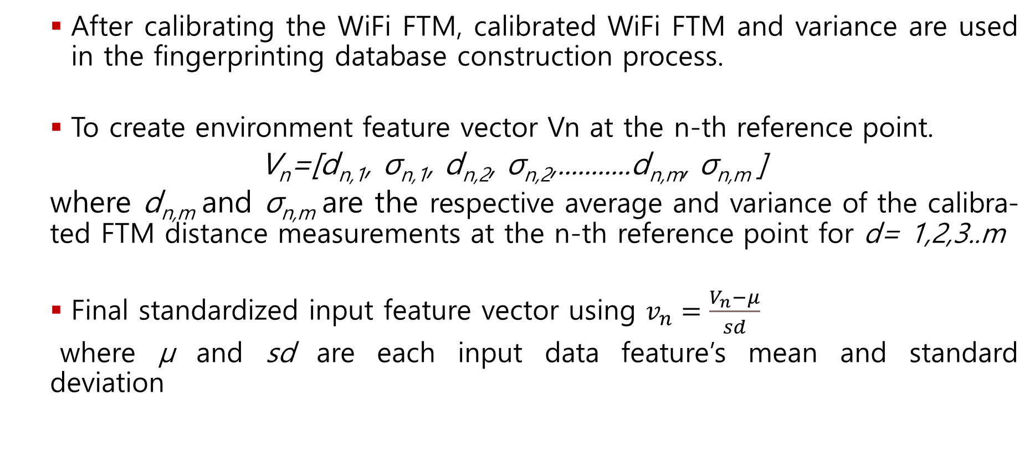
Data Preprocessing
After calibrating the WiFi FTM, calibrated WiFi FTM and variance are used in the fingerprinting database construction process.
To create environment feature vector Vn at the n-th reference point.
V_{n}=[d_{n,1}, σ_{n,1}, d_{n,2}, σ_{n,2},...........d_{n,m}, σ_{n,m} ]
where d_{n,m} and σ_{n,m} are the respective average and variance of the calibra-ted FTM distance measurements at the n-th reference point for d= 1,2,3..m
Final standardized input feature vector using $v_{n}=\frac{V_{n}^{ }−μ}{sd}$
where μ and sd are each input data feature’s mean and standard deviation
Notes:
With a dataset at hand, it was necessary to preprocess and filter the data to ensure its accuracy and usefulness. In this part of my presentation, I'll share with you the steps I took to preprocess and filter the data, including Outlier removal and Kalman Filter.

Slide 13
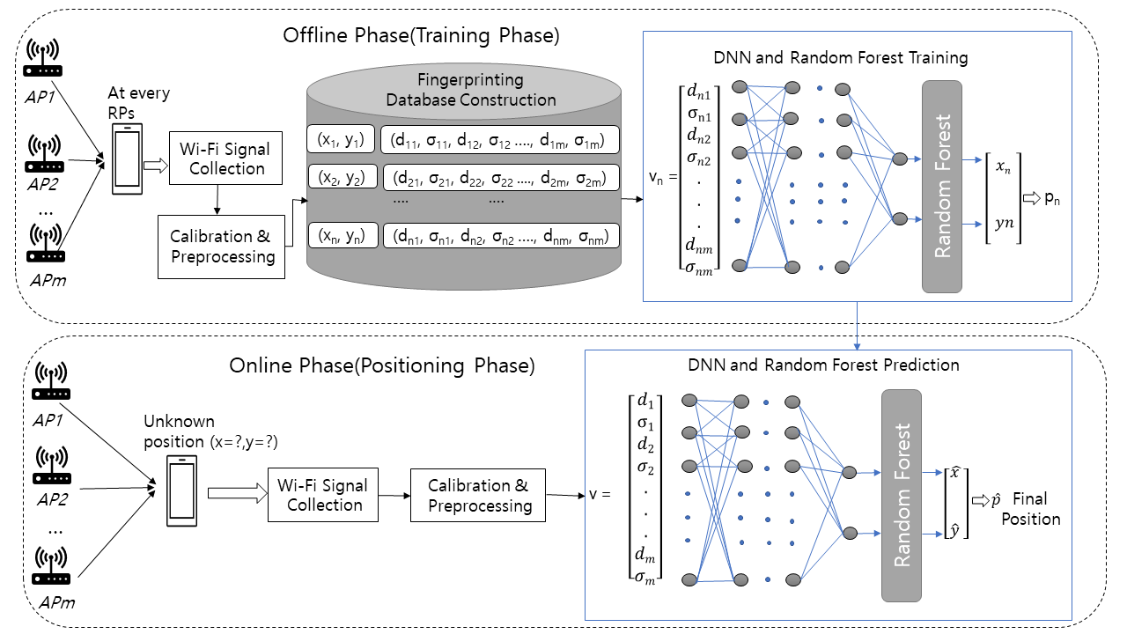
Proposed Model Architecture
Figure: Proposed model architecture

Slide 14

DNN Model Training
DNN consists of input, hidden, and output layers.
After preprocessing and calibration with the proper offset value, the input dataset vector is divided the data into a train: test sets in 0.7:0.3. for training the DNN model
It gives two output for the x-axis and y-axis after training the model.
Figure: DNN model architecture

Slide 15
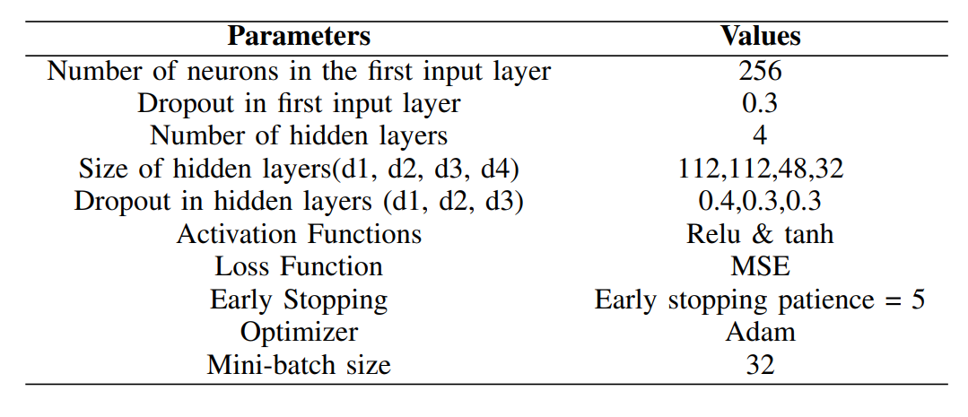
DNN Model Training(Contd.)
Used parameters and values in DNN training are listed in the table below.

Slide 16

Random Forest Algorithm training
After training the DNN model, we train the Random forest algorithm.
It is a collection of decision trees.
The trees are trained independently, and their predictions are combined through a majority vote or average.
It takes less training time and runs efficie-ntly with larger datasets.

Slide 17
Random Forest Algorithm training (contd.)
The maximum depth of trees and the number of features used per tree are tu-ned using GridSearchCV.
Cross validation value was set to 5 to prevent overfitting in the training time.
Best parameters used for Random Forest training are:
n-estimators=50, maximum depth= 200.
Trained Random Forest algorithm results for best hyperparameters: MSE=0.268883 RMSE=0.518540

Slide 18
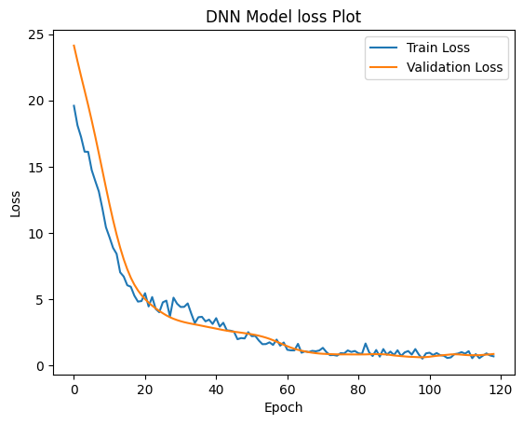
Result and Analysis
DNN learning Loss using calibrated Wi-Fi FTM and standard deviation training dataset.
Figure: DNN model loss plot with n epochs

Slide 19
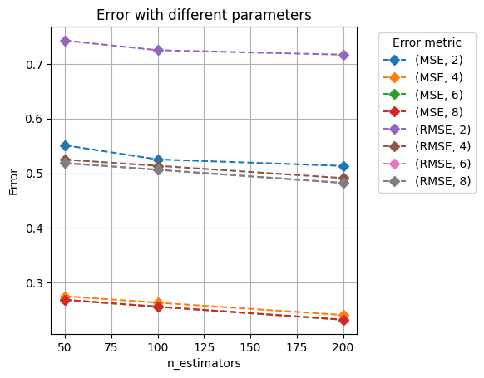
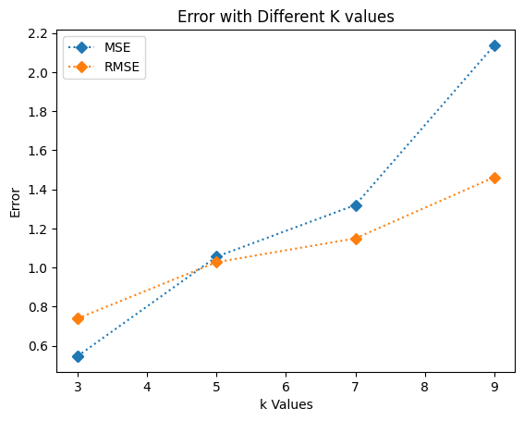
Result and Analysis (contd.)
After training, trained the DNN output random forest and KNN regression model.
Figure: Random Forest model ‘s performance comparison
Figure: KNN model’s performance with different K values

Slide 20
Result and Analysis (contd.)
At first tested the 30% data of the training dataset in the trained model.
To evaluate the accuracy of the trained model, we collected test data in two ways.
Firstly, we collected data from each reference point(36) on the same day as the training data.
Secondly, we evaluated the trained model’s performance on random unkn-own points in a cross-day scenario. There were more noises of human mov-ment than in the first case when reading the data.

Slide 21
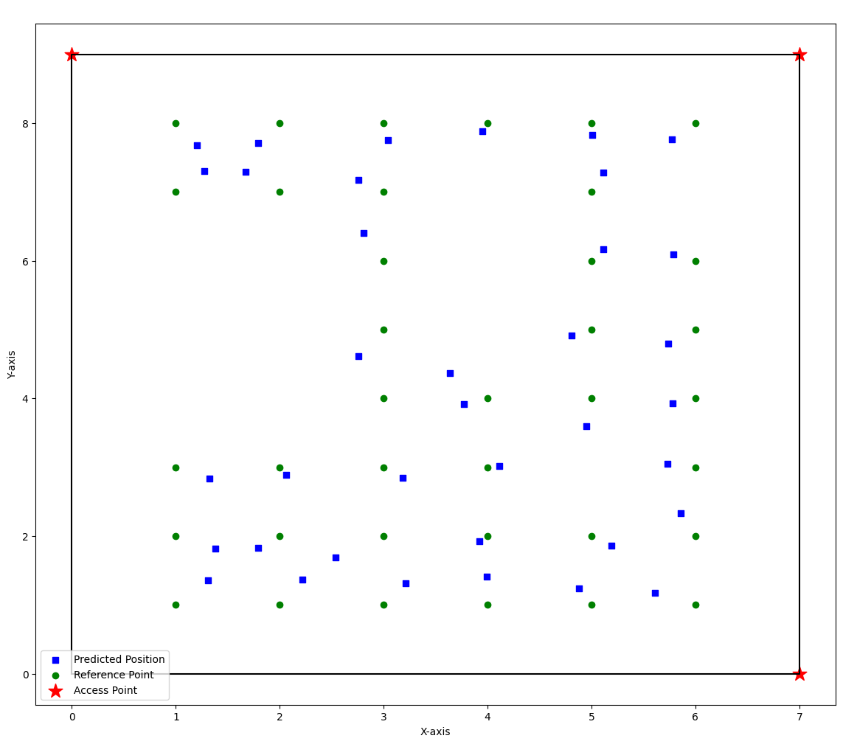
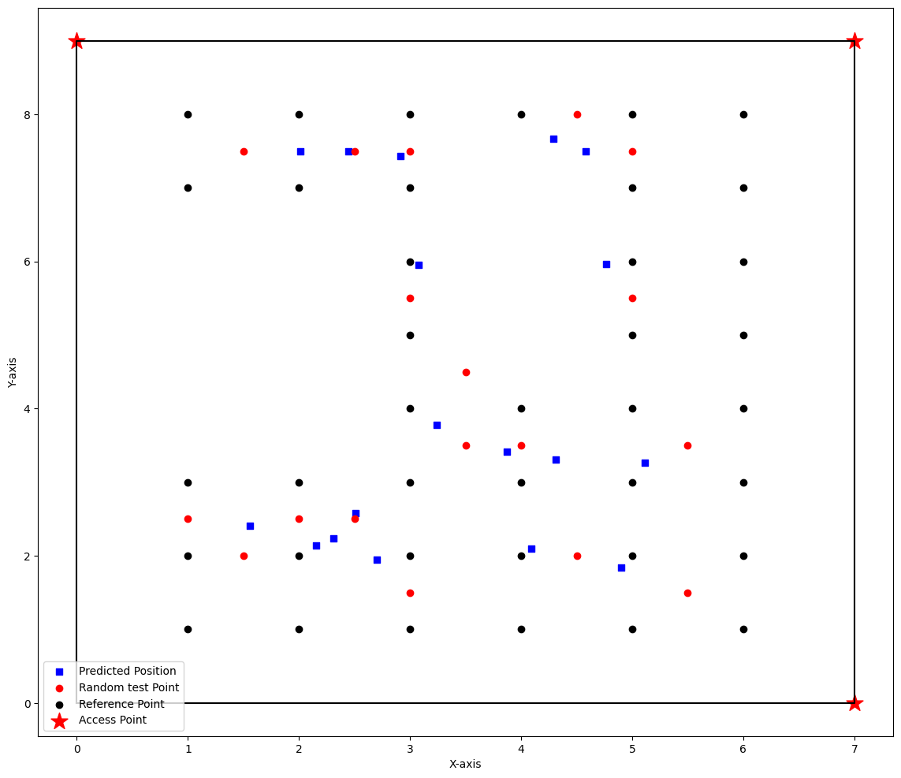
Result and Analysis (contd.)
Figure: Testing in Reference Points
Figure: Testing other than Reference Points

Slide 22
Result and Analysis (contd.)
Tried with different combinations, but DNN and Random forest combination have less error and higher robustness.
The distance error between the predicted and true positions can be seen in the above plot.
By seeing this plot, we can say that the Non-Line of Sight (NLOS) position has a higher error than the Line of Sight (LOS) with access points.

Slide 23
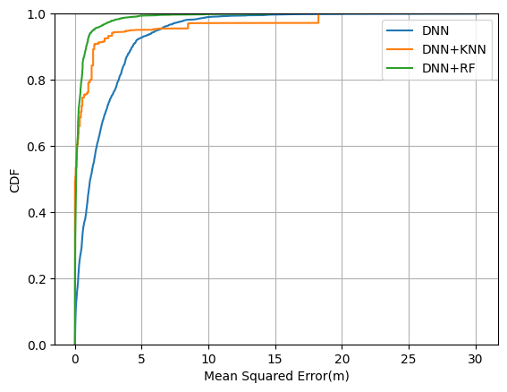
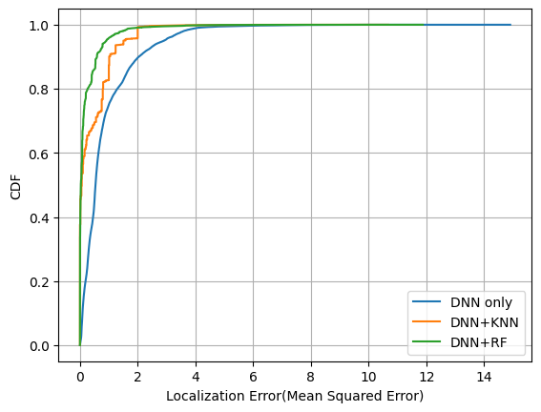
Result and Analysis (contd.)
Utilized the localization error's empirical cumulative distribution funct-ion (CDF).
The DNN and Random Forest hybrid models outperformed the other two, as the CDF plot below demonstrates.
Figure: CDF of positioning error for the non reference point
Figure: CDF of positioning error for the reference point

Slide 24
Result and Analysis (contd.)
Model | MSE (m) |  | RMSE (m) |  | MAPE (%) |  | R2
 | Calibrated | Raw | Calibrated | Raw | Calibrated | Raw | Calibrated | Raw
DNN | 0.66 | 0.79 | 0.82 | 0.89 | 22.57 | 22.89 | 0.73 | 0.65
DNN+KNN | 0.26 | 0.32 | 0.51 | 0.57 | 14.41 | 15.02 | 0.90 | 0.88
DNN+RF | 0.12 | 0.16 | 0.343 | 0.40 | 10.80 | 11.35 | 0.95 | 0.93
Table: Performance table for testing point on non reference points
Model | MSE (m) |  | RMSE (m) |  | MAPE (%) |  | R2
 | Calibrated | Raw | Calibrated | Raw | Calibrated | Raw | Calibrated | Raw
DNN | 0.41 | 0.49 | 0.64 | 0.70 | 20.60 | 18.64 | 0.88 | 0.85
DNN+KNN | 0.19 | 0.20 | 0.40 | 0.44 | 9.56 | 15.78 | 0.94 | 0.94
DNN+RF | 0.11 | 0.16 | 0.33 | 0.40 | 8.19 | 14.74 | 0.96 | 0.95
Table: Performance table for testing point on reference points

Slide 25
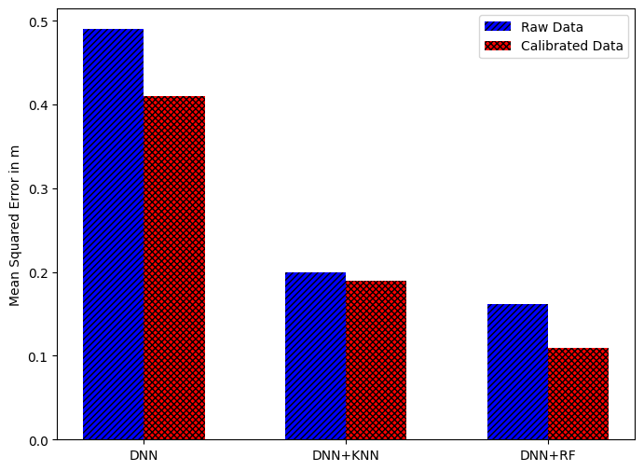
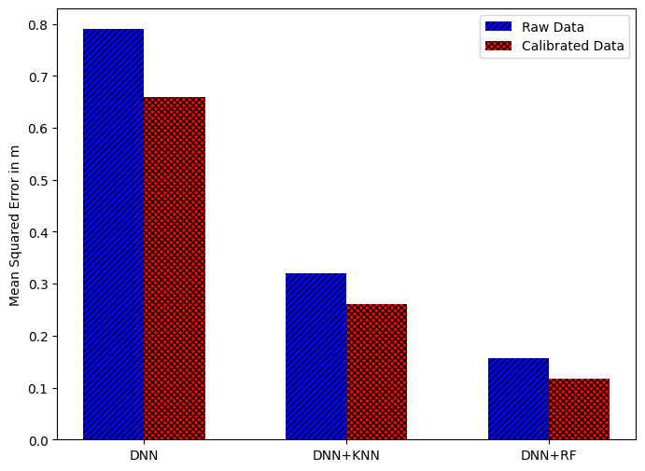
Result and Analysis (contd.)
Below plots highlight the superiority of the proposed DNN and RF hybrid model in achieving accurate localization compared to the other two models
Moreover, calibration data significantly improved the performance of the DNN model in achieving lower localization errors than using raw data.
Figure: MSE positioning error of testing on non-reference points
Figure: MSE positioning error of testing on the reference points

Slide 26
Conclusion and Future Work
Studied and verified the test of proposed Indoor fingerprinting based on DNN and Random Forest with calibrated Wi-Fi FTM.
To reduce the fluctuation of Wi-Fi FTM results, defined features in 802.11mc protocol and applied deep neural network, which can model complex nonlinear data relationships.
Random forest algorithm is useful for understanding the relationship between features and predicted output.
The evaluation results of the proposed model showed improved accuracy than the existing algorithm
In the future, I plan to explore the research work using numbers of multiple access points and smartphones through more customized algorithms/models in a big room.
Will explore and very this model in a more diverse and larger environment by combining FTM and RSS.
Notes:
In conclusion, my research on this topic has yielded some findings, which have important implications for Indoor positioning. I'm excited to share these findings with you all today.

Slide 27
References
Guo, G., Chen, R., Ye, F., Peng, X., Liu, Z., & Pan, Y. (2019). Indoor Smartphone Localization: A Hybrid WiFi RTT-RSS Ranging Approach. IEEE Access, 7, 176767–176781. https://doi.org/10.1109/ACCESS.2019.2957753
Chigullapally, M., & Patnaik, S. (2020). Wi-Fi 802.11mc Distance Classification and Error Reduction using Machine Learning. 2020 5th International Conference on Communication and Electronics Systems (ICCES), 599–604. https://doi.org/10.1109/ICCES48766.2020.9137922
Jung, B.-G., Chung, B. C., Yim, J., Yoo, Y.-S., & Park, H. (2021). Learning based Wi-Fi RTT Range Estimation. 2021 International Conference on Information and Communication Technology Convergence (ICTC), 1030–1032. https://doi.org/10.1109/ICTC52510.2021.9620218
Dong, Y., Arslan, T., & Yang, Y. (2022). Real-Time NLOS/LOS Identification for Smartphone-Based Indoor Positioning Systems Using WiFi RTT and RSS. IEEE Sensors Journal, 22(6), 5199–5209. https://doi.org/10.1109/JSEN.2021.3119234
Eberechukwu, P., Park, H., Laoudias, C., Horsmanheimo, S., & Kim, S. (2022). DNN-based Indoor Fingerprinting Localization with WiFi FTM. 2022 23rd IEEE International Conference on Mobile Data Management (MDM), 367–371. https://doi.org/10.1109/MDM55031.2022.00082
Hashem, O., Youssef, M., & Harras, K. A. (2020). WiNar: RTT-based Sub-meter Indoor Localization using Commercial Devices. 2020 IEEE International Conference on Pervasive Computing and Communications (PerCom), 1–10. https://doi.org/10.1109/PerCom45495.2020.9127363
Wang, J., & Park, J. (2021). An Enhanced Indoor Positioning Algorithm Based on Fingerprint Using Fine-Grained CSI and RSSI Measurements of IEEE 802.11n WLAN. Sensors, 21(8), 2769. https://doi.org/10.3390/s21082769
Notes:
Before I wrap up my presentation, I'd like to acknowledge the sources that informed my research. I'll be sharing a list of references at the end of my presentation, which includes the academic papers and other resources that helped me to develop my research.

Slide 28
Thank You for your attention!

